Slide 1
Spring 2024 CLT (Classic Learning Test) Wednesday, April 24th

Slide 2
Test Security
Generally, we will follow the same policies and procedures that we do for state testing.
The CLT does NOT have a secure browser, so test administrators must monitor students at all times during testing.
One proctor is required for every 35 students.
Students may not advance to the next section until directed by the test administrator, and may not ever return to a previous section.
Students that leave campus before finishing may not complete the test on a subsequent day, even if they left due to illness.

Slide 3
Test Security
Prohibited Items
Cell phones
Calculators
Smart watches
Books
Resource/reference material of any kind
Snacks (only allowed during break)
Invalidations are entered by the Test Administrator into the Administration Report after testing.

Slide 4
Test Administration Resources
School Administrator Guide
Instructions for Importing Students
Test Administration Manual & Checklist
Schedule & Script
Test Day Help Guide
Accommodations Info
Accommodations Documentation Guide
Evaluation Services Website www.escambiaschools.org/eval

Slide 5
Section Lengths
Admit Students and Give General Announcements (10 minutes)
Administrative Material (10 minutes)
Exam
Verbal Reasoning: 40 minutes (40 questions)
Grammar/Writing: 35 minutes (40 questions)
Break: 10 minutes
Quantitative Reasoning: 45 minutes (40 questions)
Closing Announcements and Student Surveys: 5 minutes
Administration Report and Proctor Survey (5 minutes)
Students are not required to take all 3 sections.

Slide 6
School Registration
The CLT must be managed at the school level. Eval Services cannot handle school registrations, importing students or accommodations at the district level.
Each school will need to designate a School Administrator for the CLT to handle these tasks.
Your school administrator will use the registration form linked in the Test Administration Manual to register your school.
Registration for a test must occur prior to importing students for that test.

Slide 7
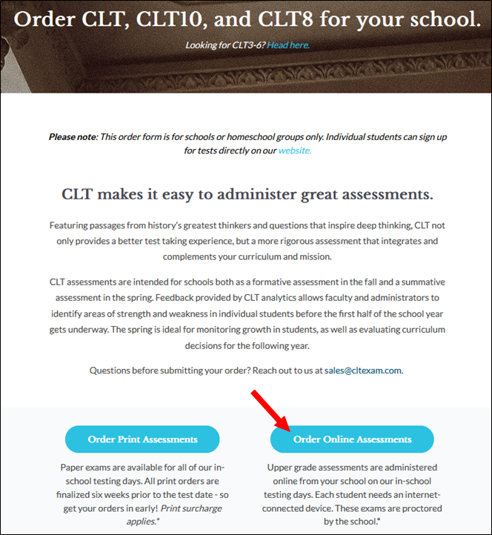
School Registration Form

Slide 8
Student Import
Importing refers to getting your students’ information into your school administrator portal by uploading your student roster. Importing must be done after you have completed school registration.
We will create your Student Registration File and share it with you through your shared drive.
The Student Registration File includes student’s First Name, Last Name, Username (email), Password (random).
Student Import Instructions & Video are in the manual.

Slide 9
Login Tickets
We will create your login tickets and share them with you through your shared drive.
You will need to print and cut out the login tickets.
The student’s username is their school email address.
The student’s password is randomly generated, but students are able to reset their passwords by clicking the Forgot Password button on the login page.
The IT Dept will make sure that they can receive the Reset Password emails.

Slide 10
Accommodations
Start with the Accommodations Info Guide.
Watch your deadlines.
Fill out the form to grant access to your Accommodations Coordinator.
Log in to the CLT Accommodations Portal.
Follow the Documentation Guidelines.
Don’t forget the Consent Form for each student and parent.

Slide 11
Schedule/Deadlines
Accommodations Due: March 27
School Registration Due: March 29
Student Import Due: April 10
Test Day: April 24
Score Release: April 30

Slide 12
Before Testing
You are responsible for training all test administrators and proctors before testing.
Practice tests are optional. Each student can take up to 3 practice tests. Practice tests can be given at school or at home.
Print or share the scripts for test administrators. Remind them to stick to the script.
Prepare your Login Tickets.
Prepare scratch paper and pencils for each classroom.
A week before the test you (School Administrator) will receive an email with your Test Access Code. Keep the code secure until test day.

Slide 13
On Test Day
Distribute test materials to test administrators.
Test Access Code
Scripts
Login tickets
Scratch paper and pencils
Prepare testing rooms (cover/remove visual aids).
Student spacing guidelines are recommended, not required.
Display the Test Day Signs on classroom doors.

Slide 14
On Test Day
If a student is disconnected during the test, log back in and resume testing. A button should appear labeled "Populate My Answers" at the top of the screen (see image below). If the student doesn't see this, have the student refresh the page. Once the button appears, have the student click it. Have the student check that all answers were repopulated.
Tech support is available via online chat. Navigate to www.cltexam.com/contact and click on the chat icon in lower right hand corner.

Slide 15
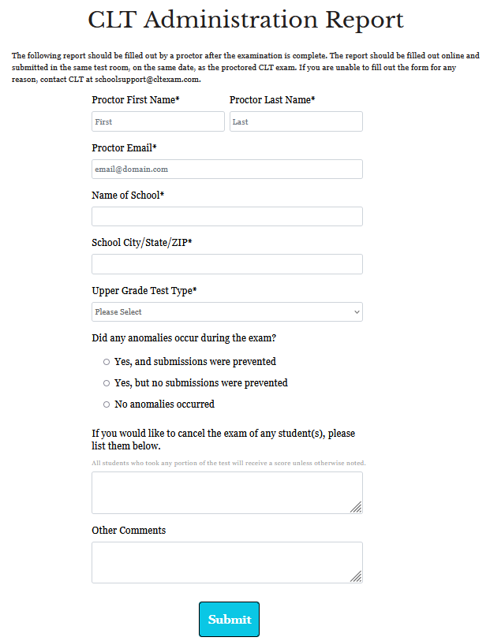
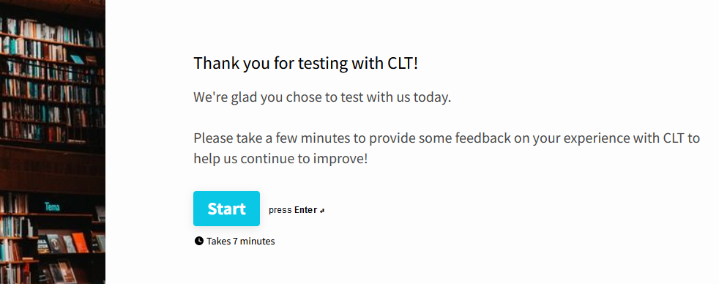
After Testing (Test Administrators)
Dismiss students
Collect and securely dispose of scratch paper
Complete the Administration Report
Complete the Proctor Survey

Slide 16
After Testing (School Administrators)
You will receive an email once scores have been released.
Scores for online tests are released the first Tuesday following the exam (April 30th).
Log in to your CLT school administrator account to view scores and analytics. Select the appropriate test type and date to view scores and analytics for that test.
Immediately send your score results files to Eval Services through your shared folder.
Students can view their own scores by logging in to their CLT accounts.
36/80 required for the ELA requirement.
11/40 required for the Algebra requirement.

